Slide 1
Movies Rental application

Slide 2
Group 4
Od-Erdene Chuluunsukh
Luvsangombo Gochoodorj
Hossam Hassan

Slide 3
Agenda
Problem Statement
Implemented Use cases
Use case Diagram
Class Diagram
Sequence Diagram
Implemented Validation
STC conclusion

Slide 4

Problem statement

Slide 5
Problem statement
The Movie Rental System is designed to facilitate the management of movie rentals for members and administrators. Each member is assigned a unique ID and their personal information, including name, address, and phone number, is securely stored. The system catalogs movies with details such as title, format, genre, director, cast, quantity, and availability status.

Slide 6
Problem statement (continued)
Members can check out movies for a standard period of 7 days (with an option to extend for an additional 3 days). Each checkout is recorded with relevant dates and will eventually include late return fines and payment records.
Administrators have a dedicated login that allows them to manage member information, add new movies to the genre, and facilitate movie checkouts.

Slide 7
Problem statement (continued)
Each Administrator must have a unique ID and other information:
First Name
Last Name
Phone Number
Each Member must have a unique ID and other information:
First Name
Last Name
Address
Phone Number

Slide 8
Problem statement (continued)
Each Movie must have the following attributes:
Title
Format (e.g., DVD, Blu-ray)
Genre
Author (Author of the movie)
Director (Director of the movie)
List of Actors
Quantity Available
Price
Availability Status (indicating if the movie is rentable)
Each Actor, Director & Author must have the following attributes:
First Name
Last Name
Bio

Slide 9
Problem statement (continued)
Each Checkout Entry must have a unique Member ID and other information:
movie
Checkout date
Due date
Each Checkout Record must have the following attributes:
member
Total amount
List of Checkout Entries

Slide 10

Implemented Use-cases

Slide 11
Implemented Use-cases
Add Members, Movie, Checkout.
Search Members by name.
Get Checkout details.
Update Member
List Members, Movies.

Slide 12
Class Diagram

Slide 13
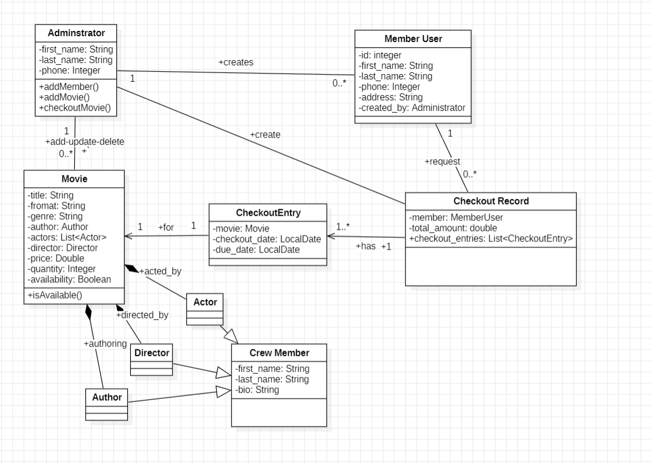
class diagram

Slide 14
Use-Case Diagram

Slide 15
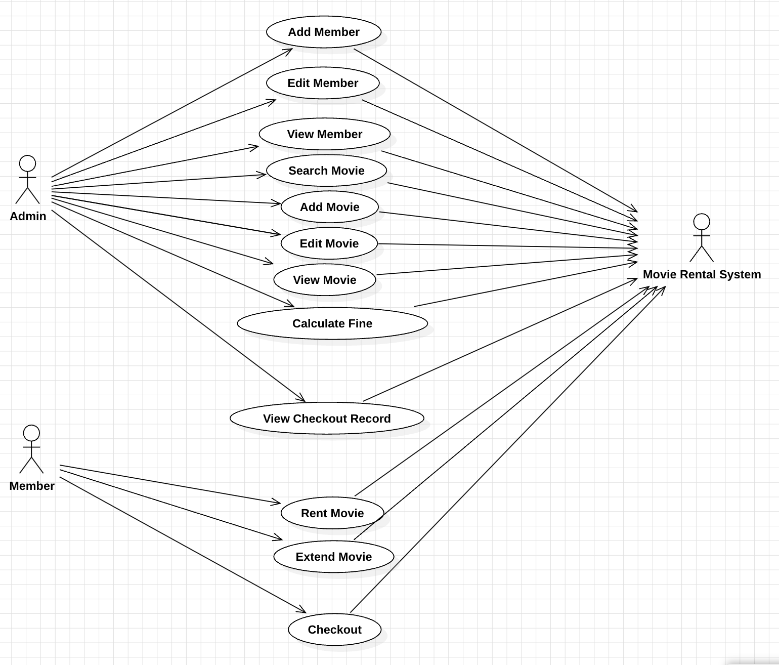
Use-Case diagram

Slide 16
Sequence diagrams

Slide 17
Sequence diagram 1
Impact factor​ | Measurement​ | Target​ | Achieved​
Audience interaction​ | Percentage (%)​ | 85​ | 88​
Knowledge retention​ | Percentage (%)​ | 75​ | 80​
Post-presentation surveys​ | Average rating​ | 4.2​ | 4.5​
Referral rate​ | Percentage (%)​ | 10​ | 12​

Slide 18
Sequence diagram 2
Impact factor​ | Measurement​ | Target​ | Achieved​
Audience interaction​ | Percentage (%)​ | 85​ | 88​
Knowledge retention​ | Percentage (%)​ | 75​ | 80​
Post-presentation surveys​ | Average rating​ | 4.2​ | 4.5​
Referral rate​ | Percentage (%)​ | 10​ | 12​

Slide 19
Sequence diagram 3
Impact factor​ | Measurement​ | Target​ | Achieved​
Audience interaction​ | Percentage (%)​ | 85​ | 88​
Knowledge retention​ | Percentage (%)​ | 75​ | 80​
Post-presentation surveys​ | Average rating​ | 4.2​ | 4.5​
Referral rate​ | Percentage (%)​ | 10​ | 12​

Slide 20
Implemented validations

Slide 21

Implemented validations
On adding new movie we validate that every field is not empty , else we will raise error for user.

Slide 22
STC Conclusion

Slide 23
STC Conclusion
Generic methods make it possible to create general-purpose methods in Java by declaring and using one or more type variables in the method. This allows a user to make use of the method using any data type that is convenient, with full compiler support for type-checking. Likewise, when individual awareness has integrated into its daily functioning the universal value of transcendental consciousness, the awareness is maximally flexible.

Slide 24
STC Conclusion
Streams in Java represent a deeper level of intelligence inherent in the concept of “collection” that has been implemented in the Java language. When intelligence expands, challenges and tasks that seemed difficult and time-consuming before can become effortless and meet with consistent success. This is one of the documented benefits of TM practice.

Slide 25
Effective delivery techniques​
Voice modulation is a powerful tool in public speaking. It involves varying pitch, tone, and volume to convey emotion, emphasize points, and maintain interest:
Pitch variation​
Tone inflection​
Volume control
Effective body language enhances your message, making it more impactful and memorable:
Meaningful eye contact
Purposeful gestures
Maintain good posture
Control your expressions

Slide 26
Navigating Q&A sessions
Know your material in advance​
Anticipate common questions​
Rehearse your responses
Maintaining composure during the Q&A session is essential for projecting confidence and authority. Consider the following tips for staying composed:​
Stay calm​
Actively listen​
Pause and reflect​
Maintain eye contact

Slide 27
Speaking impact​
Your ability to communicate effectively will leave a lasting impact on your audience​
Effectively communicating involves not only delivering a message but also resonating with the experiences, values, and emotions of those listening

Slide 28
Dynamic delivery​
Learn to infuse energy into your delivery to leave a lasting impression​
One of the goals of effective communication is to motivate your audience
Metric​ | Measurement​ | Target​ | Actual​
Audience attendance​ | # of attendees​ | 150​ | 120​
Engagement duration​ | Minutes​ | 60​ | 75​
Q&A interaction​ | # of questions​ | 10​ | 15​
Positive feedback​ | Percentage (%)​ | 90​ | 95​

Slide 29
Final tips & takeaways​
Consistent rehearsal​
Practice makes perfect, so strengthen your familiarity with the presentation​
Refine delivery style​
Pacing, tone, and emphasis​
Timing and transitions​
Aim for seamless, professional delivery​
Practice audience
Enlist colleagues to listen & provide feedback​
Seek feedback​
Reflect on performance​
Explore new techniques​
Set personal goals​
Iterate and adapt

Slide 30
Speaking engagement metrics​
Impact factor​ | Measurement​ | Target​ | Achieved​
Audience interaction​ | Percentage (%)​ | 85​ | 88​
Knowledge retention​ | Percentage (%)​ | 75​ | 80​
Post-presentation surveys​ | Average rating​ | 4.2​ | 4.5​
Referral rate​ | Percentage (%)​ | 10​ | 12​

Slide 31
THANK YOU
Brita Tamm​
502-555-0152​
brita@firstupconsultants.com​
www.firstupconsultants.com

